Slide 2
Introduction
General theme: “growing in grace and knowledge of the Lord” : 2 Pet. 3:18
It is critical to establish a foundation & not remain “babes” ! 1 Pet. 2:2; 1 Cor. 14:20; 2 Pet. 3:1; Matt. 6:33; 2 Pet. 1:5-11
Christians must put “first things first”: Matt. 6:33
Christians must diligently strive for spiritual maturity: 2 Pet. 1:3-11
Christians must reject worldliness: Jas. 1:27; 4::4
Christians must remain faithful: Rev. 2:10
Christians must be diligent Bible students: 2 Tim. 2:15; Hos. 4:6
Christians must fulfill their responsibilities: Rom. 14:12

Slide 3
Introduction
In today’s society the family is increasingly referred to as an “endangered species.”
There was a time when the family and home were the rule, not the exception. Not so in our time!
Consider these alarming statistics:
2017: ~2.24 M marriages, ~1.1 M divorces.
Cohabitation rates rising (~20% of U.S. men & women).
Divorce rate remains at a dismal ~50%.
Illegitimacy rate has skyrocketed! 40.7% overall

Slide 4
Introduction
Consider these alarming statistics:
27% of children (under 18) live in single-parent homes.
70% of prison inmates grew up w/out a father.
Fatherless children 3X more like to fail in school.
Increased chance of divorce & illegitimacy.
Two times more likely to be high school dropouts.
Illegitimacy rates have increased ~60% since 1980.
40% of teenage girls in high school today will eventually the “head of households.”

Slide 5
Growing in the Grace and Knowledge of the Lord (7):
The Family
Psalm 128:3-4

Slide 6
Family & nation
“The strength of a nation is derived from the integrity of its homes.”
—Confucius
“The hand that rocks the cradle rules the world.”
—Unknown
As the family goes so goes the nation: Psa. 33:12; Prov. 14:34
The Family

Slide 7
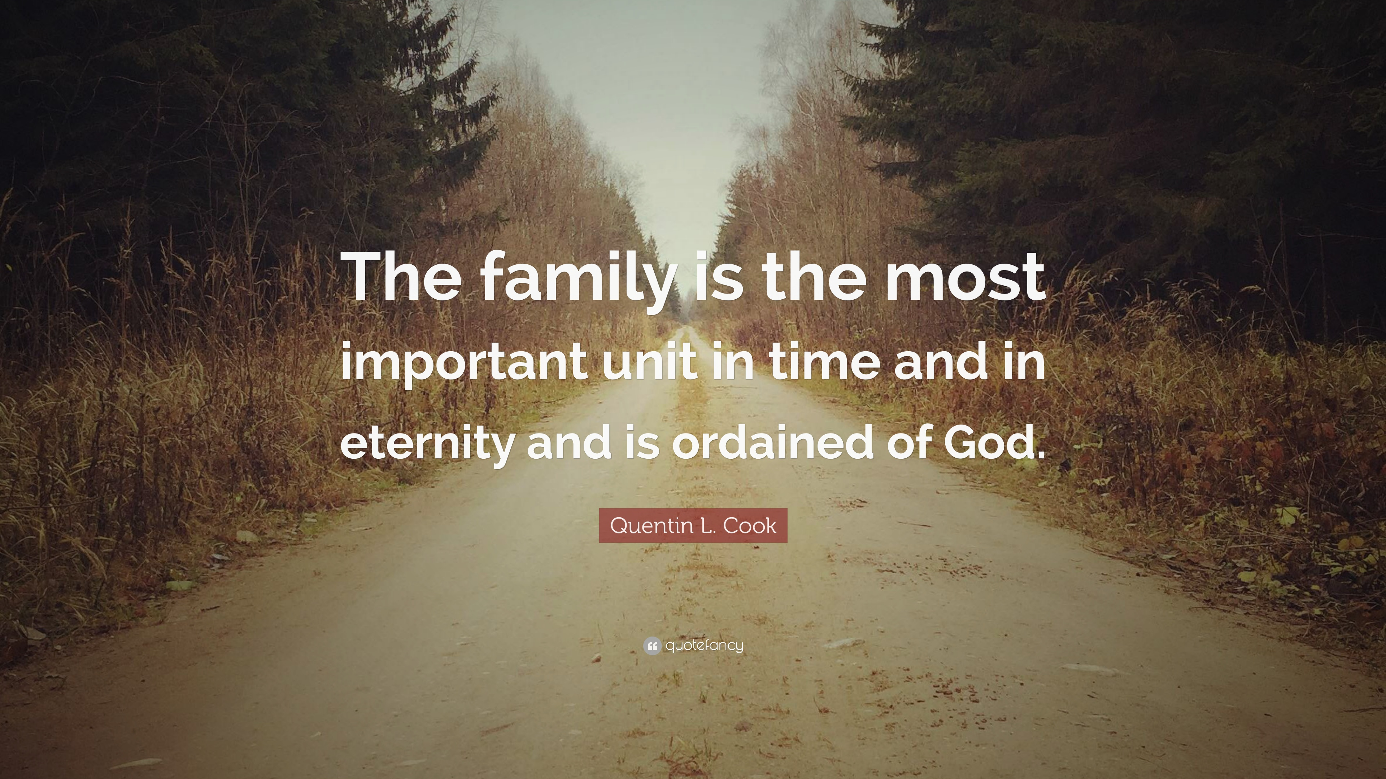
Family ordained by God
“And the Lord God caused a deep sleep to fall on Adam, and he slept; and He took one of his ribs, and closed up the flesh in its place. 22 Then the rib which the Lord God had taken from man He made into a woman, and He brought her to the man.
23 And Adam said:
‘This is now bone of my bones
And flesh of my flesh;
She shall be called Woman,
Because she was taken out of Man.’
24 Therefore a man shall leave his father and mother and be joined to his wife, and they shall become one flesh. 25 And they were both naked, the man and his wife, and were not ashamed.”
Genesis 2:21-25
Marriage and home ordained and regulated by God: Gen. 2:18
God used divine anesthetic and made woman for man: Gen. 2:21-25
Marriage is good and favorable (Prov. 18:22); the only legitimate outlet for mankind’s sexual needs: Heb. 13:4
The Family

Slide 8
Purpose of marriage
Silly question? NO! So many marry for the wrong reasons!
Marriages made for the wrong reasons usually are unhappy and do not last: Matt. 19:9; 1 Jn. 5:3
Divine purposes of marriage:
Meet man’s needs: 1 Cor. 11:11-12
Propagate and nurture the human family: Gen. 1:28; Eph. 6:1-4; Rom. 1:24-27
Moral purity of the human family: 1 Cor. 7:2; Heb. 13:4
The Family

Slide 9
Marriage is for life!
We all need to learn that lesson! Rom. 7:1-4
Only two scriptural reasons which allow one to be married more than once: (1) death of spouse (Rom. 7:1-4; 1 Cor. 7:39-40), and (2) sexual infidelity of spouse (Matt. 19:9).
God permits “separation”; but both spouses must remain unmarried: 1 Cor. 7:10-11
God’s rule for marriage: “One man for one woman for life with only one exception.”
The Family

Slide 10
Responsibilities in marriage
Marriage is not one-sided; both husbands and wives have responsibil-ities, duties, privileges, etc.
Mutual responsibilities:
Love one another: Eph. 5:33; Titus 2:4
Companionship: Gen. 2:18
Satisfaction of physical desires: Heb. 13:4; 1 Cor. 7:1-5
Faithfulness: 1 Cor. 6:18; Gal. 5:19-20; Matt. 19:9
The Family

Slide 11
Responsibilities in marriage
Marriage is not one-sided; both husbands and wives have responsibil-ities, duties, privileges, etc.
Responsibilities of wives and mothers:
Submit to husband: 1 Pet 3:1-6; Col. 3:18; 1 Tim. 2:12
Loving mother: 1 Tim. 2:15; 2 Tim. 1:5; 3:15
Homemaker: Titus 2:4-5; Prov. 31:10-31
The Family

Slide 12
Responsibilities in marriage
Marriage is not one-sided; both husbands and wives have responsibil-ities, duties, privileges, etc.
Responsibilities of husbands and fathers:
Head of family: Eph. 5:23-25; 1 Cor. 11:3
Love wife: Eph. 5:25; 1 Pet. 3:7
Responsible father: Eph. 6:4; Prov. 22:6; 13:24; 19:18; 29:15-17
The Family

Slide 13
Responsibilities of children
Everyone in the family has res-ponsibilities, including children.
Responsibilities of children:
Obey parents: Eph. 6:1-2; Lk. 2:51-53; Rom. 1:29-32; Prov. 15:20; 17:25; Deut. 21:18-21; Prov. 30:17; Deut. 27:16
Learn to work: Lam. 3:27; Eph. 4:28; 1 Tim. 5:4
Learn to love God and His word: Eph. 6:4; Prov. 22:6 2 Tim. 3:15
The Family

Slide 14
Conclusion
To lead a happy & fulfilling family life we must follow God’s word.
Each family member must learn, accept and faithfully discharge their God-given responsibilities to the family.
Obeying God in this realm of life is just as important as obeying Him in other realms (e.g., doctrinal correctness).
Are you obeying God in this realm of life?
The Family

