Slide 1
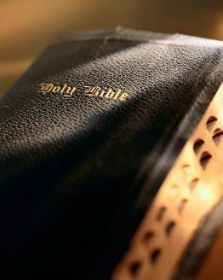

Slide 2
²⁰ “But do you want to know, O foolish man, that faith without works is dead? ²¹ Was not Abraham our father justified by works when he offered Isaac his son on the altar? ²² Do you see that faith was working together with his works, and by works faith was made perfect? ²³ And the Scripture was fulfilled which says, ‘Abraham believed God, and it was accounted to him for righteousness.’ And he was called the friend of God. ²⁴ You see then that a man is justified by works, and not by faith only.”
James 2:20-24
Introduction
The epistle of James is a very practical book.
Written by the Lord’s half-brother: Gal. 1:18, 19
A “pillar” in the church at Jerusalem: Acts 12:17; Gal. 2:9
He presided at the council in Jerusalem: Acts 15
Written to a Jewish audience: Jas. 1:1
One of the first NT epistles written (c. a.d., 46-49).
About “fruits, not roots” of Christianity; known for treatment of “faith and works.”
Are You God’s Friend?

Slide 3
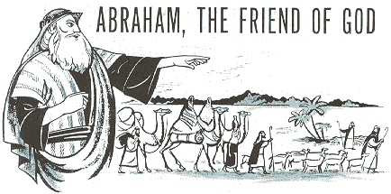
Are You God’s Friend?
James 2:20-24

Slide 4
Salvation by “faith only” is false
²⁴ “You see then that a man is justified by works, and not by faith only. ²⁶ For as the body without the spirit is dead, so faith without works is dead also.”
James 2:24, 26
Luther championed this prominent, prevalent and false doctrine.
Usually focus on James 2:24, 26 when countering the false teaching of salvation by “faith only.”
What does God mean when He says “believe” ?
“Abraham believed God, and it was accounted for right-eousness” : v. 23
When? When “he offered Isaac his son on the altar”: v. 21
Abraham’s faith validated by action, by obedience! cf. v. 19
Are You God’s Friend?

Slide 5
Salvation by “faith only” is false
³⁶ “He that believeth on the Son hath everlasting life: and he that believeth not the Son shall not see life; but the wrath of God abideth on him.”
John 3:36 (KJV)
³⁶ “He that believeth on the Son hath eternal life; but he that obeyeth not the Son shall not see life, but the wrath of God abideth on him.”
John 3:36 (ASV)
⁸ “but to those who are self-seeking and do not obey the truth, but obey unrighteousness — indignation and wrath,”
Romans 2:8
¹⁷ “For the time has come for judgment to begin at the house of God; and if it begins with us first, what will be the end of those who do not obey the gospel of God? ”
1 Peter 4:17
Don’t need James 2 to successfully refute sal-vation by “faith only”!
Context and wording of John 3 proves there’s more to belief in John 3:16 than “mental assent.”
Compare Hebrews 3:18-19 where “did not obey” (v. 18) is equivalent to “unbelief” (v. 19).
Clearly from John 3 an objective reader can discern a saving belief is an obedient belief.
Are You God’s Friend?

Slide 6
Am I a friend of God?
³⁴ “But when the Pharisees heard that He had silenced the Sadducees, they gathered together. ³⁵ Then one of them, a lawyer, asked Him a question, testing Him, and saying, ³⁶ ‘Teacher, which is the great command-ment in the law?’ ³⁷ Jesus said to him, ‘You shall love the Lord your God with all your heart, with all your soul, and with all your mind.’ ³⁸ This is the first and great commandment. ³⁹ And the second is like it: ‘You shall love your neighbor as yourself.’ ⁴⁰ On these two commandments hang all the Law and the Prophets.’”
Matthew 22:34-40
Do I have the faith of Abraham? Heb. 11:6, 13-15
Folks try to make serving God and going to heaven either too complicated or too easy: Acts 14:22
Compliance with the two great commandments both require:
A total abandonment of selfishness on our part.
A total dedication to serving others before self.
Are You God’s Friend?

Slide 7
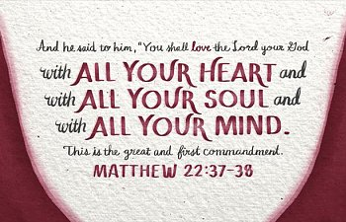
First and great commandment
²⁷ “You shall love the Lord your God with all your heart, with all your soul, with all your strength, and with all your mind.”
Luke 10:27
God cannot be second place in our lives! Not even a “close second”! Matt. 5:6; 6:33
How committed are you to serving God? Matt. 16:24-27; Jn. 12:15
“The Christian ideal has not been tried and found wanting, it has been found difficult and left untried.”
—G. K. Chesterton
Are You God’s Friend?

Slide 8
First and great commandment
¹³ “Enter by the narrow gate; for wide is the gate and broad is the way that leads to destruction, and there are many who go in by it. ¹⁴ Because narrow is the gate and difficult is the way which leads to life, and there are few who find it.”
Matthew 7:13-14
²⁴ “Then Jesus said to His disciples, ‘If anyone desires to come after Me, let him deny himself, and take up his cross, and follow Me. ²⁵ For whoever desires to save his life will lose it, but whoever loses his life for My sake will find it. ²⁶ For what profit is it to a man if he gains the whole world, and loses his own soul? Or what will a man give in exchange for his soul?”
Matthew 16:24-26
²¹ “For to me, to live is Christ, and to die is gain.”
Philippians 1:21
²¹ “For to me, to live is , and to die is .”
Philippians 1:21
Why? God requires us to:
?
Make a complete self-sacrifice: Rom. 12:1-2
?
Perfect holiness: 2 Cor. 6:16-7:1; Rom. 8:29; Gal. 2:20
Be totally committed: 1 Cor. 6:19-20; Phil. 1:21
Anything short of this means we won’t make it to heaven! Matt. 16:24-27; 7:13-14
Are You God’s Friend?

Slide 9
Second great commandment
God always comes first; our fellowman second.
In the grand scheme of things I always come in last!! Matt. 20:16
Christ gave us the perfect example regarding all this: Phil. 2:1-8
Are You God’s Friend?

Slide 10
¹ “Therefore if there is any consolation in Christ, if any comfort of love, if any fellowship of the Spirit, if any affection and mercy, ² fulfill my joy by being like-minded, having the same love, being of one accord, of one mind. ³ Let nothing be done through selfish ambition or conceit, but in lowliness of mind let each esteem others better than himself. ⁴ Let each of you look out not only for his own interests, but also for the interests of others.
⁵ Let this mind be in you which was also in Christ Jesus, ⁶ who, being in the form of God, did not consider it robbery to be equal with God, ⁷ but made Himself of no reputation, taking the form of a bondservant, and coming in the likeness of men. ⁸ And being found in appearance as a man, He humbled Himself and became obedient to the point of death, even the death of the cross.”
Philippians 2:1-8

Slide 11
Second great commandment
Applications:
Family: 1 Tim. 5:8
Eph. 5:25; 6:4
Brethren: Jn. 13:34-35; 1 Jn. 3:16, 18; 1 Pet. 1:22
Needy: Eph. 4:28; 1 Jn. 3:17
Lost: Matt. 16:26; 2 Cor. 5:10-11a; Mk. 9:42-48; Rom. 10:1; Rom. 9:1-3
Are You God’s Friend?

Slide 12
Conclusion
Recall our text: James 2:20-24
Abraham was called a “friend of God” because his faith was an active, working faith.
Abraham was totally committed! Jas. 2:21
What about you? Are you a “friend of God” ?
Are You God’s Friend?

